Slide 1
somatic cell nuclear transfer Animal Cloning
By Stephen Giang

Slide 2
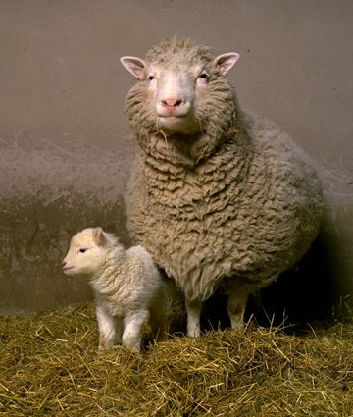
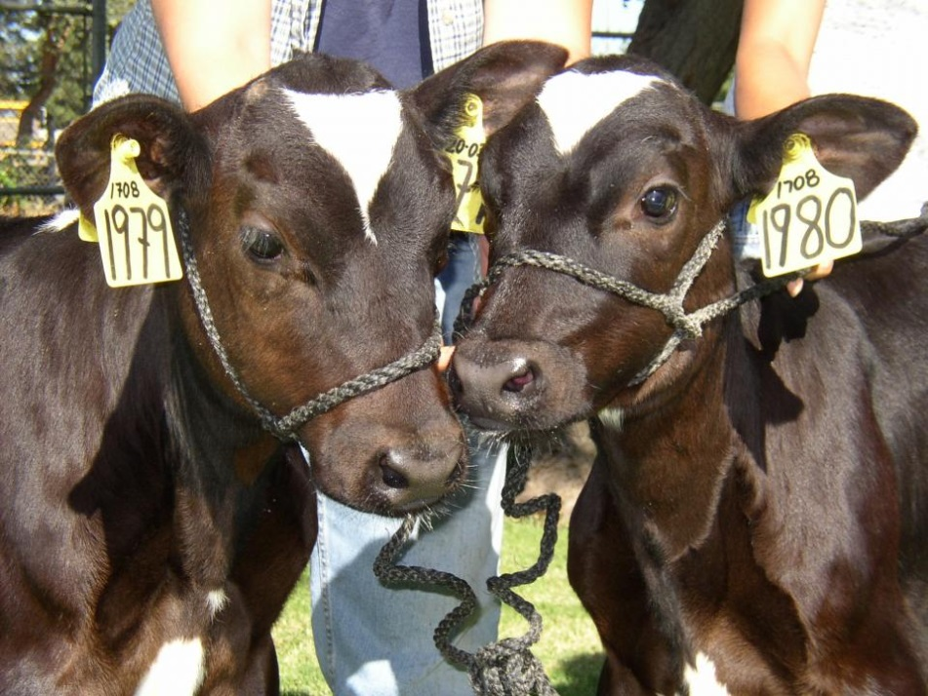
What is Animal Cloning
Notes:
http://www.understandinganimalresearch.org.uk/animals/areas-research/animal-cloning/

Slide 3
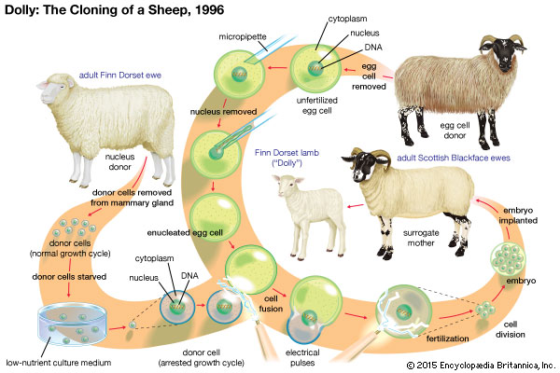
How CAN I DO IT
Notes:
https://www.genome.gov/25020028/cloning-fact-sheet/

Slide 4
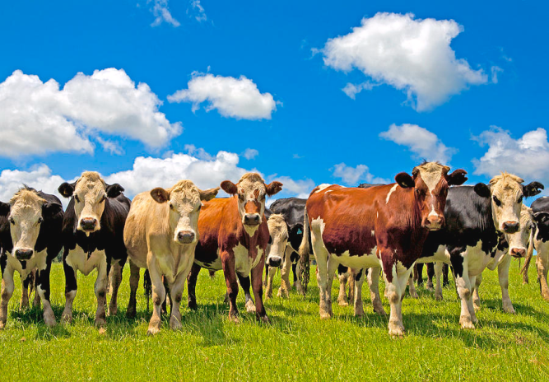
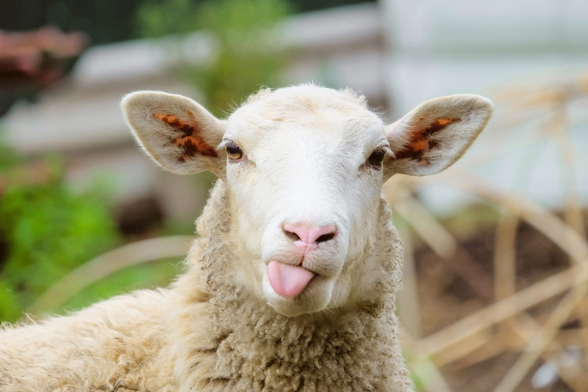
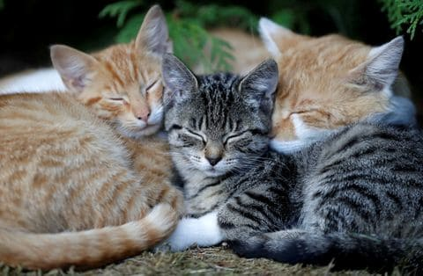
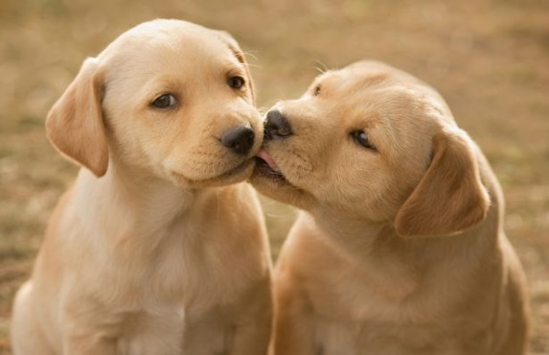
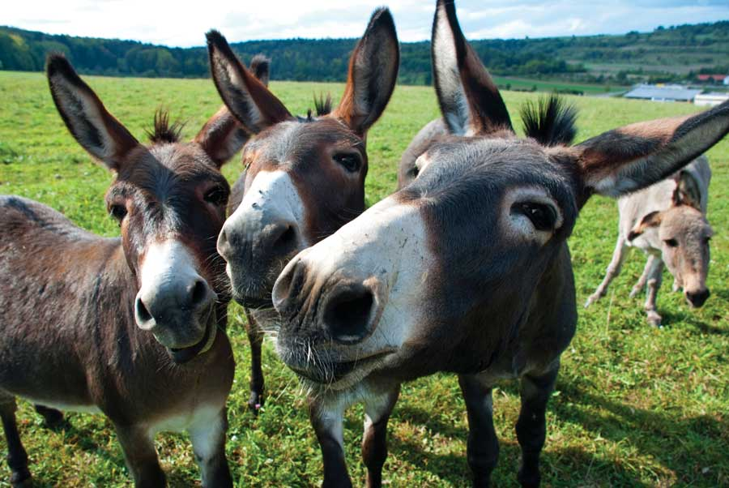
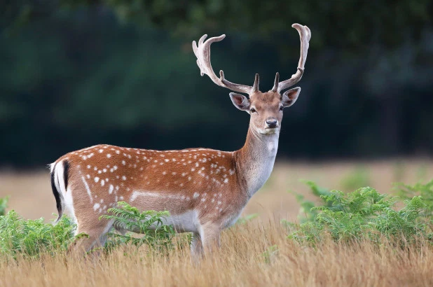
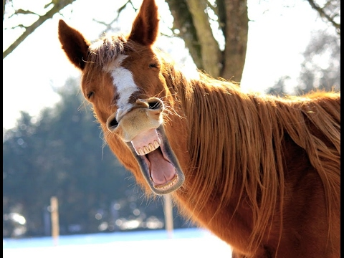
What Animals Have We Cloned
Notes:
https://www.manataka.org/page1033.html

Slide 5

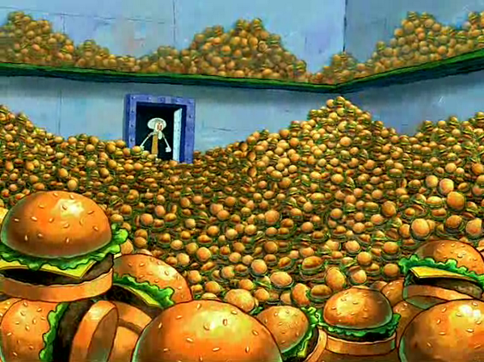
Why We do Animal Cloning
Notes:
https://www.fda.gov/AnimalVeterinary/SafetyHealth/AnimalCloning/default.htm

Slide 6
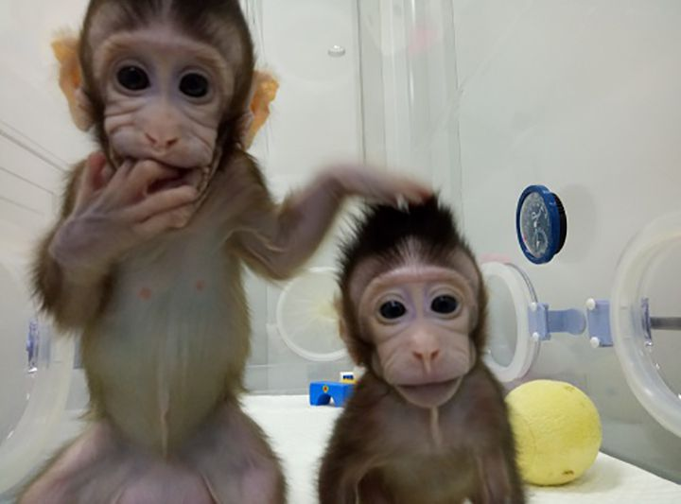
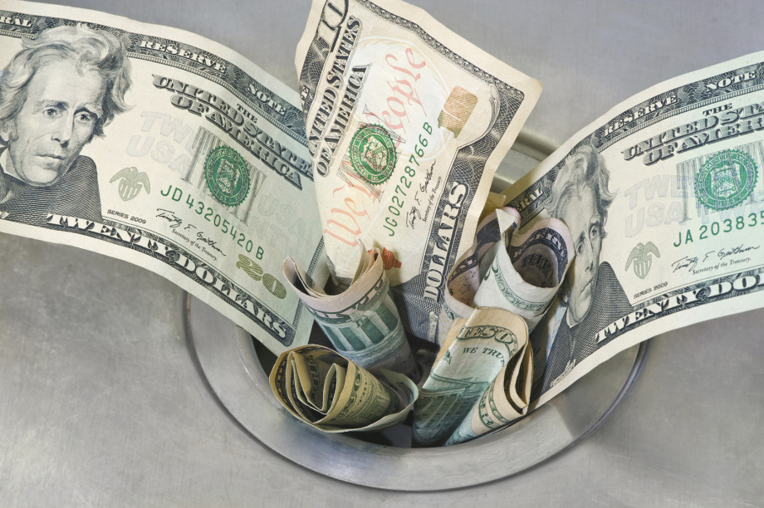
Ethics
Notes:
https://www.sciencenewsforstudents.org/article/animal-clones-double-trouble

Slide 7

Where are you

